Slide 1
Chapter 12
SUPERVISED LEARNING
Categorization, Decision Trees
Part 1
Cios / Pedrycz / Swiniarski / Kurgan

Slide 2
Outline
What is Inductive Machine Learning?
- Categorization of ML Algorithms
- Generation of Hypotheses
Decision Trees
Rule Algorithms
- DataSqueezer
Hybrid Algorithms
  - CLIP4
  - Set Covering algorithm
© 2007 Cios / Pedrycz / Swiniarski / Kurgan

Slide 3
What is Inductive Machine Learning?
How do we understand learning?
We define learning as the ability of an agent (like an algorithm) to improve its own performance based on past experience.
© 2007 Cios / Pedrycz / Swiniarski / Kurgan

Slide 4
What is Inductive Machine Learning?
Machine Learning (ML) can be also defined as the ability of a computer program:
to generate a new data structure that is different from an old one,
like production IF…THEN… rules from input numerical or nominal data
© 2007 Cios / Pedrycz / Swiniarski / Kurgan

Slide 5
What is Inductive Machine Learning?
The key concept in inductive ML is that of a hypothesis, which is generated by a given algorithm
A hypothesis approximates some concept
We assume that only a teacher/oracle knows the true meaning of a concept and describes the concept, via means of examples, to a learner whose task is to generate a hypothesis that best approximates the concept
Example: concept of a “pneumonia” can be described by
(high fever, pneumonia)
(weak, pneumonia)
© 2007 Cios / Pedrycz / Swiniarski / Kurgan

Slide 6
What is Inductive Machine Learning?
Inductive ML algorithms generate hypotheses that approximate concepts;
hypotheses are often expressed in the form of production rules, and we say that
the rules “cover” the examples.
An example is covered by a rule when it satisfies all conditions of the IF part of the rule.
© 2007 Cios / Pedrycz / Swiniarski / Kurgan

Slide 7
What is Inductive Machine Learning?
Any inductive ML process is broken into two phases:
Learning phase, where the algorithm analyzes the training data and recognizes similarities among data objects. The result is, for example, a tree or a set of production rules.
Testing phase, where the rules are evaluated on new data, and when performance measures are concurrently computed.
© 2007 Cios / Pedrycz / Swiniarski / Kurgan

Slide 8
What is Inductive Machine Learning?
Some ML algorithms, such as decision trees or rule learners, generate explicit rules, which can be inspected, learned from, or modified by users.
This is an important advantage of this type of ML algorithms over many other data mining methods.
© 2007 Cios / Pedrycz / Swiniarski / Kurgan

Slide 9
What is Inductive Machine Learning?
There are several levels (called a pyramid) of knowledge:
Data - bottom of the pyramid
Warehouse
(carry original information)
(Extracted) Databases
(contain only useful for analysis information)
Knowledge / Information
(generated from a database, e.g., a set of rules)
Meta-knowledge (knowledge about knowledge) - top
© 2007 Cios / Pedrycz / Swiniarski / Kurgan

Slide 10
Categorization of ML algorithms
ML algorithms operate in one of two basic modes:
Supervised Learning / learning from examples
(all examples have the corresponding target class)
Unsupervised Learning / learning from observation
(examples/patterns/instances do not have target class)
© 2007 Cios / Pedrycz / Swiniarski / Kurgan

Slide 11
Categorization of ML algorithms
Unsupervised Learning: learning system on its own needs to discover “classes” in the data by discovering common unifying properties (with none or minimal help from the user)
Clustering – finding groups of “similar” examples
Association Rules - generation of rules describing frequently co-occurring items
© 2007 Cios / Pedrycz / Swiniarski / Kurgan

Slide 12
Categorization of ML algorithms
Incremental vs. non-incremental
In non-incremental learning all of the training examples are presented simultaneously (as a batch file) to the algorithm.
In incremental learning the examples are presented one at a time (or in groups) and the algorithm improves its performance based on the new examples without the need of re-training.
Most ML algorithms are non-incremental.
© 2007 Cios / Pedrycz / Swiniarski / Kurgan

Slide 13
Categorization of ML algorithms
Any supervised learning algorithm must be provided with a training data set. Let us assume that such a set, S, consists of M training data pairs, belonging to C classes:
S = {(xi ∈ cj) | i = 1,...,M; j = 1,...,C}
training data pairs are often called examples, where xi is an n-dimensional pattern vector whose components are its features and cj is a known class.
The mapping function f, c = f(x), is not known.
© 2007 Cios / Pedrycz / Swiniarski / Kurgan

Slide 14
Categorization of ML algorithms
Supervised Learning: aka from examples. The user, serving as the teacher, provides examples describing each class/concept.
Rote learning – system is “told” the correct rules
Learning by analogy – system is told the correct response to a similar task and it needs to adapt to find solution to a new situation
© 2007 Cios / Pedrycz / Swiniarski / Kurgan

Slide 15
Categorization of ML algorithms
Case-based learning - the learning system stores all historical cases along with their outcomes. When a new case is encountered the system tries to adapt to it by comparing with all the stored cases.
Explanation-based learning - the system analyzes a set of example solutions in order to determine why each was successful or not.
© 2007 Cios / Pedrycz / Swiniarski / Kurgan

Slide 16
Categorization of ML algorithms
Conceptual clustering – different from classical clustering because it can deal with nominal data.
Conceptual clustering consists of two tasks:
1) finding clusters in a given data set, and
2) characterization (labeling) that generates a concept description for each cluster found by clustering.
© 2007 Cios / Pedrycz / Swiniarski / Kurgan

Slide 17
Categorization of ML algorithms
Inductive vs. Deductive Learning
Deduction infers information that is a logical consequence of the information stored in the data. It is provably correct - if the data describing some domain are correct.
Ex. A=>B and A (are both true) => B (modus ponens rule)
A=>B (true) and ~B (false) => ~A (modus tollens)
all men are mortal and John is man => John mortal
Induction infers generalized information/knowledge
from data by searching for regularities among the data.
It is correct for the given data but only plausible outside of the data.
© 2007 Cios / Pedrycz / Swiniarski / Kurgan

Slide 18
Categorization of ML algorithms
Structured vs. Unstructured Algorithms
In learning hypotheses (i.e., approximating concepts) there is a need to choose a proper description language.
There are two basic types of domains: structured and unstructured.
An example of an unstructured domain is usually described by an <attribute, value> pair.
Description languages applicable to unstructured domains are decision trees, production rules, and decision tables (used in rough sets).
For domains having an internal structure, a first-order calculus language is often used.
© 2007 Cios / Pedrycz / Swiniarski / Kurgan

Slide 19
Generation of Hypotheses
target
DECISION | CONDITION1 | CONDITION2 | INDEX
A | low | normal | 2
A | low | normal | 3
A | normal | normal | 3
A | normal | low | 2
A | normal | low | 1
B | low | high | 4
B | low | low | 4
B | high | normal | 4
A | normal | low | 2
A | normal | normal | 2
A | normal | normal | 2
A | normal | normal | 3
A | low | normal | 1
B | normal | high | 4
B | high | low | 4
B | high | normal | 4
A | normal | low | 4
A | low | normal | 2
A | low | normal | 2
A | normal | normal | 4
A | normal | normal | 2
B | low | high | 4
B | high | low | 4
B | high | normal | 4
© 2007 Cios / Pedrycz / Swiniarski / Kurgan

Slide 20
Generation of Hypotheses
target
DECISION | CONDITION1 | CONDITION2 | INDEX
A | low | normal | 2
A | low | normal | 3
A | normal | normal | 3
A | normal | low | 2
A | normal | low | 1
B | low | high | 4
B | low | low | 4
B | high | normal | 4
A | normal | low | 2
A | normal | normal | 2
A | normal | normal | 2
A | normal | normal | 3
A | low | normal | 1
B | normal | high | 4
B | high | low | 4
B | high | normal | 4
A | normal | low | 4
A | low | normal | 2
A | low | normal | 2
A | normal | normal | 4
A | normal | normal | 2
B | low | high | 4
B | high | low | 4
B | high | normal | 4
RULES for DECISION = A (4 rules)
1. IF CONDITION1 = normal AND CONDITION2 = normal THEN DECISION = A
2. IF INDEX = 2 THEN DECISION = A
3. IF CONDITION1 = normal AND CONDITION2 = low THEN DECISION = A
4. IF CONDITION1 = low AND CONDITION2 = normal THEN DECISION = A
RULES for DECISION = B (3 rules)
1. IF CONDITION1 = high AND INDEX = 4 THEN DECISION = B
2. IF CONDITION1 = low AND INDEX = 4 THEN DECISION = B
3. IF CONDITION1 = normal AND CONDITION2 = high AND INDEX = 4 THEN DECISION = B
© 2007 Cios / Pedrycz / Swiniarski / Kurgan

Slide 21
Generation of Hypotheses
DECISION | CONDITION1 | CONDITION2 | INDEX
A | low | normal | 2
A | low | normal | 3
A | normal | normal | 3
A | normal | low | 2
A | normal | low | 1
B | low | high | 4
B | low | low | 4
B | high | normal | 4
A | normal | low | 2
A | normal | normal | 2
A | normal | normal | 2
A | normal | normal | 3
A | low | normal | 1
B | normal | high | 4
B | high | low | 4
B | high | normal | 4
A | normal | low | 4
A | low | normal | 2
A | low | normal | 2
A | normal | normal | 4
A | normal | normal | 2
B | low | high | 4
B | high | low | 4
B | high | normal | 4
ASSOCIATION RULES (no “decision” target)
1. DECISION = B AND INDEX = 4
2. CONDITION1 = normal AND CONDITION2 = normal AND INDEX = 2
3. CONDITION2 = normal AND INDEX = 3
4. DECISION = A AND INDEX = 2
etc.
© 2007 Cios / Pedrycz / Swiniarski / Kurgan

Slide 22









Generation of Hypotheses
Information System
IS = < S, Q, V, f >
where
S is a finite set of examples S = {e₁, ..., e_{i}, ..., e_{M}}
M is the number of examples
Q is a finite set of features Q = {F₁, ..., F_{j}, ..., F_{n}}
n is the number of features
is a set of feature values
is the domain of feature
a value of feature
is an information function such that
for every and
© 2007 Cios / Pedrycz / Swiniarski / Kurgan

Slide 23
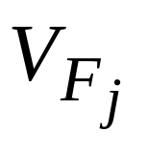
Generation of Hypotheses
Information System
The set S is also called the learning/training data.
S is a subset of the entire universe, which is known only to the teacher/oracle
it is defined as a Cartesian product of all feature domains (j=1,2…n)
Ex. F1(a,b,c,d) F2(1,2,3)
F1XF2 =(a1,a2, a3, b1,b2, b3,…) – 12 combinations
© 2007 Cios / Pedrycz / Swiniarski / Kurgan

Slide 24
Generation of Hypotheses
A travel agency wants to learn which customers generate the most profit based on these features:
1. Type of a call: local, long distance, international.
2. Language fluency: fluent, fluent with accent, speaks badly, foreign language only.
3. Ticket type: local (0-250 miles), short distance (250-1000 miles), long distance (over 1000 miles).
4. Age: 1st range: 18-25 years, 2nd range: 25-40 years, 3rd range: 40-60 years, 4th range: 60-80 years, 5th range: 80 and older.
The decision attribute is:
5. Purchase ticket: Buy/Not buy
(Buy: positive examples, Not buy: negative examples)
© 2007 Cios / Pedrycz / Swiniarski / Kurgan

Slide 25
Generation of Hypotheses
S | F1 | F2 | F3 | F4 | F5
Example | Type of call | Lang. fluency | Ticket type | Age | Decision attribute
E1 E2 | Local (1) Local (1) | Fluent (1) Fluent (1) | Long (3) Local (1) | Very young (1) Old (4) | Buy (1) Buy (1)
E3 | Long dist. (2) | Not fluent (3) | Short (2) | Very old (5) | Buy (1)
E4 E5 E6 | Intern. (3) Local (1) Local (1) | Accent (2) Fluent (1) Not fluent (3) | Long (3) Short (2) Short (2) | Very old (5) Middle (3) Very young (1) | Buy (1) Buy (1) Not buy (2)
E7 E8 E9 | Intern. (3) Intern. (3) Local (1) | Fluent (1) Foreign (4) Not fluent (3) | Short (2) Long (3) Long (3) | Middle (3) Young (2) Middle (3) | Not buy (2) Not buy (2) Not buy (2)
IF (F1= 1) AND (F2= 1) THEN F5 = 1
IF Type of call = Local AND Language fluency = Fluent THEN Decision = Buy
© 2007 Cios / Pedrycz / Swiniarski / Kurgan

Slide 26
Generation of Hypotheses
Information System defined for our example:
S = {e₁,…e₉}, M = 9
Q = {F₁, …F₅}, n = 5
V_{F1}= {Local, Long dist., International}
V_{F2} = {Fluent, Accent, Not fluent, Foreign}
V_{F3} = {Local, Short, Long}
V_{F4} = {Very young, Young, Middle, Old, Very old}
V_{F5} = {Buy, Not buy}
© 2007 Cios / Pedrycz / Swiniarski / Kurgan

Slide 27
Generation of Hypotheses
It is important to establish a balance between the generated rules generalization and specialization ability to get a set of rules that have good predictive power.
Def.
A general rule is one that covers many (positive) training examples.
A specialized rule, may cover, in an extreme case, only one example.
© 2007 Cios / Pedrycz / Swiniarski / Kurgan

Slide 28
Generation of Hypotheses
The rules can be generalized/specialized using the following techniques:
Replace constants with variables:
a more general rule is obtained by replacing constants
in the rules that have identical IF part,
by a single variable and thus merging them into one rule
IF F1= krystyna THEN student
IF F1= konrad THEN student
IF F1= karol THEN student
can be replaced by a more general rule:
IF F1= Soic THEN student
© 2007 Cios / Pedrycz / Swiniarski / Kurgan

Slide 29
Generation of Hypotheses
We can also use disjuncts for rule generalization, and conjuncts for rule specialization:
IF F1= 1 AND F2= 5 THEN class1
is a more specialized rule (uses conjunct AND)
than
IF F1= 1 THEN class1
(OR)
IF F2= 5 THEN class1
The last two rules are in (implied) disjunction
(any collection of production rules is always OR-ed)
© 2007 Cios / Pedrycz / Swiniarski / Kurgan

Slide 30
Generation of Hypotheses
Move up in a hierarchy for generalization
If there is a known hierarchy the generalization can be done by replacing the conditions involving the knowledge at the lower level by the common conditions involving the knowledge at the higher level.
IF F1= canary THEN class = sing
IF F1= nightingale THEN class = sing
can be replaced (if hierarchy of “singbirds” exists) by
IF F1= Singbird THEN class = sing
Chunking
Is based on the assumption that given the goal every problem encountered on the way to this goal can be treated as a sub-goal.
Then we can generate rules for each of the sub-goals, and put them together.
© 2007 Cios / Pedrycz / Swiniarski / Kurgan

Slide 31
Decision Trees
Decision tree consists of nodes and branches connecting the nodes. The nodes located at the bottom of the tree are called leaves, and indicate classes.
The top node in the tree, called the root, contains all training examples that are to be divided into classes.
All nodes but leaves in the tree are called decision nodes since they specify a specific decision to be performed at this node based on a single feature.
Each decision node has a number of children nodes that is equal to the number of values a given feature assumes.
© 2007 Cios / Pedrycz / Swiniarski / Kurgan

Slide 32
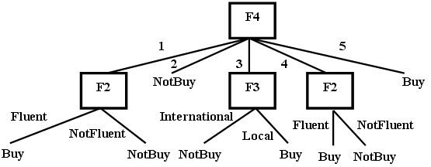
Decision Trees
© 2007 Cios / Pedrycz / Swiniarski / Kurgan

Slide 33
Decision Trees
All decision tree algorithms are based on Hunt’s concept learning algorithm.
It is a method used by humans when learning simple concepts:
it is done by finding key distinguishing features between two (always!) categories, represented by the positive and negative training examples.
© 2007 Cios / Pedrycz / Swiniarski / Kurgan

Slide 34
Decision Trees
Hunt’s algorithm
Given: A set of training examples, S
1. Select the most discriminatory / significant feature
2. Split the entire set, S, located at the root of the tree, into several subsets using the selected feature.
The number of children nodes is equal to the number of values the selected feature takes on.
3. Recursively find the most significant feature for each subset generated in step 2 and top-down split it into subsets.
If each subset (a leaf node) contains examples belonging to one class only then stop, otherwise go to step 3.
Result: The decision tree
(note: rules can be written out from the tree)
© 2007 Cios / Pedrycz / Swiniarski / Kurgan

Slide 35
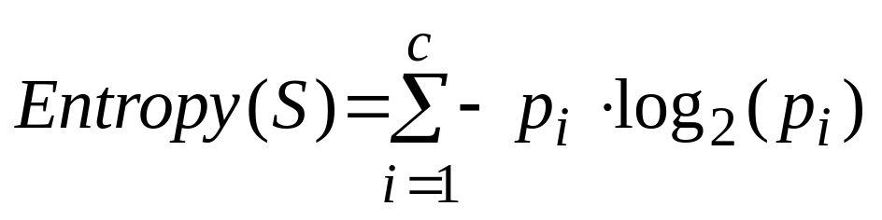
Decision Trees
Shannon’s entropy is most often used as a criterion for selecting the most significant/discriminatory feature for splitting the data on:
where: p_{i} – probability/proportion of the examples belonging to the i^{th} class
If there are 2 classes:
and the probabilities (p_{i}) are equal (1/2) then Entropy (S) = 1
If p₁ = 1 (or p₂ = 1) then Entropy (S) = 0
In general:
0<= Entropy (S) <= log C
© 2007 Cios / Pedrycz / Swiniarski / Kurgan

Slide 36
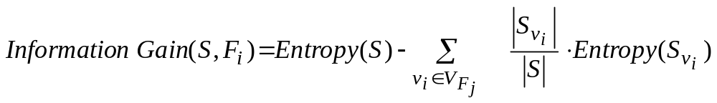
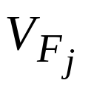
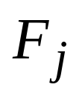
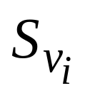

Decision Trees
Information Gain measures reduction of entropy caused by knowing the value of a feature F_{j} :
where
is a set of all possible values of feature
is a subset of S, for which feature
has value v_{i}.
InfoGain is used to select the best (reducing entropy the most) feature at each step of growing a decision tree.
© 2007 Cios / Pedrycz / Swiniarski / Kurgan

Slide 37
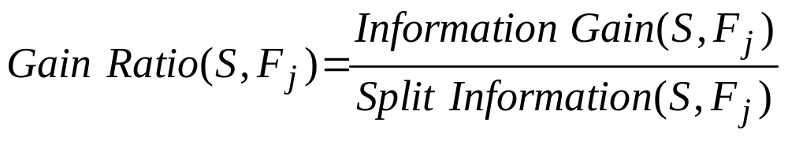
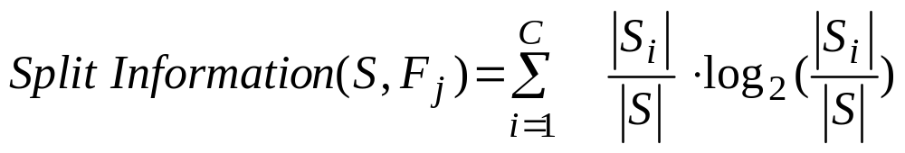
Decision Trees
To eliminate bias in calculating the InfoGain, which happens when two or more features have the same value of InfoGain, the feature with smaller number of values is selected, using a measure called Gain Ratio:
where:
Split Information is the entropy of S with respect to values of feature F_{j}.
Using Gain Ratio results in generation of smaller trees.
© 2007 Cios / Pedrycz / Swiniarski / Kurgan

Slide 38
Decision Trees
ID3 algorithm
Given: A set of training examples, S
1. Create the root node containing the entire set S
2. If all examples are positive (or negative) then stop: decision tree has one node
3. Otherwise (general case)
  3.1 Select feature F_{j} that has the largest InfoGain value
  3.2 For each value v_{i} from the domain of feature F_{j}:
a) add a new branch corresponding to this feature value v_{i} and a new node, which stores all the examples that have value v_{i} for feature F_{j}
b) if the node stores examples belonging to only one class then it is a leaf node,
else add below this node a new sub-tree, and go to step 3
Result: A decision tree
© 2007 Cios / Pedrycz / Swiniarski / Kurgan

Slide 39
Decision Trees
ID3 algorithm uses inductive bias during learning,
namely, it prefers small over large decision trees.
Decision tree consists of disjunctions of conjunctions of the feature values:
this allows for representing it by an equivalent set of IF…THEN… rules
© 2007 Cios / Pedrycz / Swiniarski / Kurgan

Slide 40
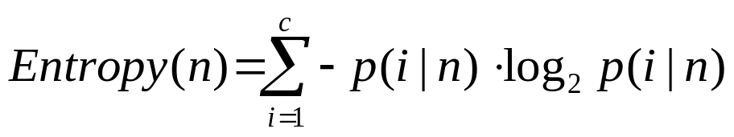
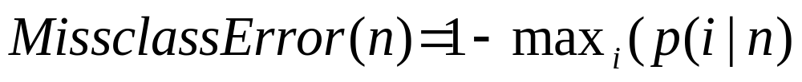
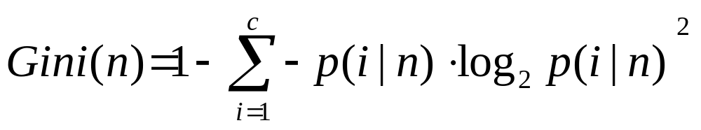
Decision Trees
Other measures for finding the most significant/discriminatory feature
for constructing a decision trees are:
where p(i│n) denotes fraction of examples from class i at node n.
Instead of entropy we can use misclassification error:
or Gini index:
© 2007 Cios / Pedrycz / Swiniarski / Kurgan

Slide 41
Decision Trees
S | F1 | F2 | F3 | F4 | F5
Example | Type of call | Lang. fluency | Ticket type | Age | Decision attribute
E1 E2 | Local (1) Local (1) | Fluent (1) Fluent (1) | Long (3) Local (1) | Very young (1) Old (4) | Buy (1) Buy (1)
E3 | Long dist. (2) | Not fluent (3) | Short (2) | Very old (5) | Buy (1)
E4 E5 E6 | Intern. (3) Local (1) Local (1) | Accent (2) Fluent (1) Not fluent (3) | Long (3) Short (2) Short (2) | Very old (5) Middle (3) Very young (1) | Buy (1) Buy (1) Not buy (2)
E7 E8 E9 | Intern. (3) Intern. (3) Local (1) | Fluent (1) Foreign (4) Not fluent (3) | Short (2) Long (3) Long (3) | Middle (3) Young (2) Middle (3) | Not buy (2) Not buy (2) Not buy (2)
© 2007 Cios / Pedrycz / Swiniarski / Kurgan

Slide 42
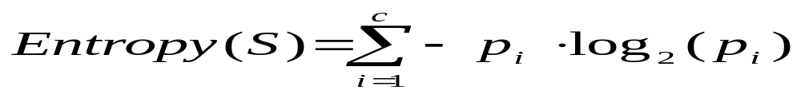
Decision Trees
Entropy calculations for travel agency data:
We calculate for attribute F1 and each of its values the following:
Having the above we calculate the information gain for feature F1 as:
© 2007 Cios / Pedrycz / Swiniarski / Kurgan

Slide 43
Decision Trees
We perform similar calculations for features F2, F3, and F4, and choose the “best” - in terms of the largest value of the InfoGain - feature.
This feature is F4, and is used at the root of the tree to split the examples into 5 subsets, which are stored at the children nodes.
Next, at each child node we perform the same calculations to find the best feature (at this level of the decision tree) to split the examples on it - until the leaf nodes contain examples belonging to one class only.
© 2007 Cios / Pedrycz / Swiniarski / Kurgan

Slide 44
Decision Trees
IF (F4=1) AND (F2=Fluent(1)) THEN F5=Buy
IF (F4=3) AND (F3=Local(1)) THEN F5=Buy
IF (F4=4) AND (F2=Fluent(1)) THEN F5=Buy
IF (F4=5) THEN F5=Buy (covers 2 examples)
© 2007 Cios / Pedrycz / Swiniarski / Kurgan

Slide 45
Decision Trees
Methods to overcome overfitting in decision tree algorithms:
Generation of several decision trees instead of one
Windowing
Pruning
Pruning helps to generate more general rules; we do it in such a way that after pruning there is no significant loss of classification accuracy.
© 2007 Cios / Pedrycz / Swiniarski / Kurgan

Slide 46
Decision Trees
Pruning can be done during the process of tree growing - pre-pruning:
we stop tree-growing when we find that no attribute significantly increases the Gain.
Pruning also can be also done after the entire tree is grown – post-pruning:
some of the branches are removed according to criterion of no significant loss of accuracy on the training data.
The extreme case of pre-pruning was introduced by Holte who proposed 1RD algorithm that builds decision trees that are only one-level deep.
He has shown that the classification performance of such trees is comparable with other more complex algorithms!
© 2007 Cios / Pedrycz / Swiniarski / Kurgan

Slide 47
Decision Trees
Windowing is a technique used for dealing with large data.
Windowing divides training data into subsets (windows) from which several decision trees are grown.
Then the best rules extracted from these trees are chosen (according to the lowest error-rate on the validation data set).
© 2007 Cios / Pedrycz / Swiniarski / Kurgan

Slide 48
Decision Trees
C4.5 algorithm is an extension of ID3 that allows for:
using continuous input values, by using (invisible to the user) build-in front-end discretization algorithm
using it on data with missing features values
© 2007 Cios / Pedrycz / Swiniarski / Kurgan

Slide 49
Decision Trees
Advantages and disadvantages of decision trees:
are computationally simple
show relationships between rules (that can be written out from a tree) so one can see the “structure” of the data
require large amounts of memory to store the entire tree for later writing out the rules
may generate very complex (long) trees that are hard to prune, and
large number of the corresponding rules - unless pruning is used to reduce their number
© 2007 Cios / Pedrycz / Swiniarski / Kurgan

Slide 50
Decision Trees
Decision trees and rule algorithms always create decision boundaries that are parallel to the coordinate axes defined by the features
In other words, they create hypercube decision regions in high-dimensional spaces
An obvious remedy for this shortcoming is to have an algorithm cable of placing a decision boundary at any angle.
This idea was used in the Continuous ID3 (CID3) algorithm (Cios and Liu, IEEE TNN, 1992).
© 2007 Cios / Pedrycz / Swiniarski / Kurgan

Slide 51
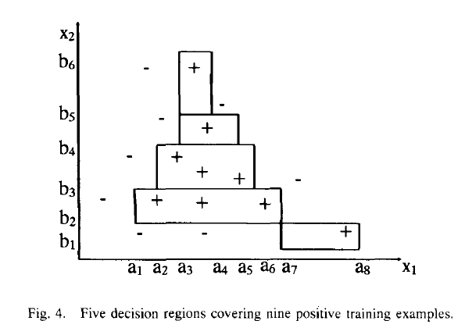
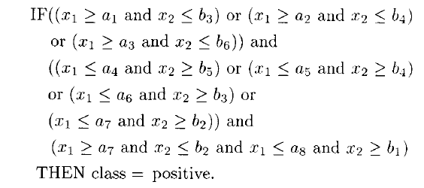
© 2007 Cios / Pedrycz / Swiniarski / Kurgan

Slide 52
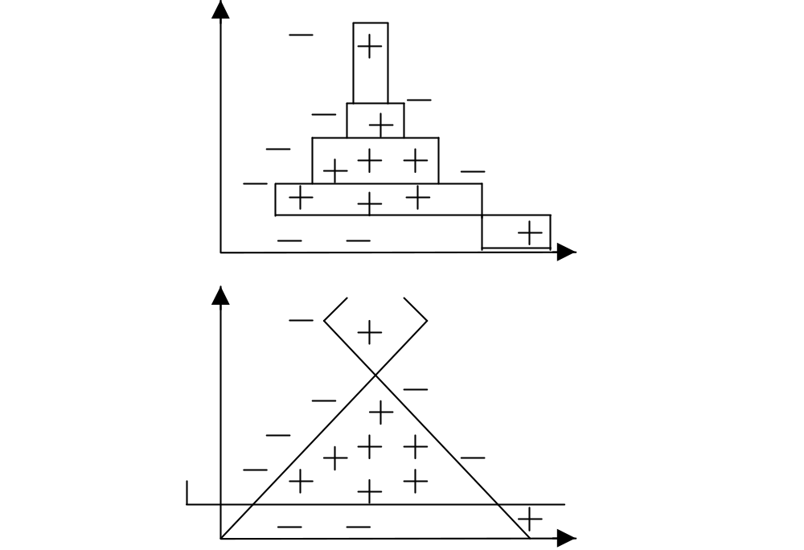
Decision Trees
© 2007 Cios / Pedrycz / Swiniarski / Kurgan

Slide 53
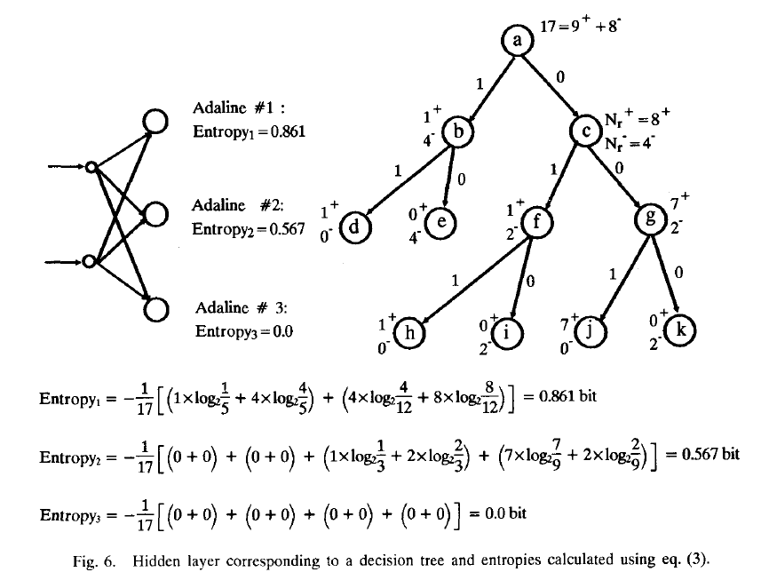
© 2007 Cios / Pedrycz / Swiniarski / Kurgan

Slide 54
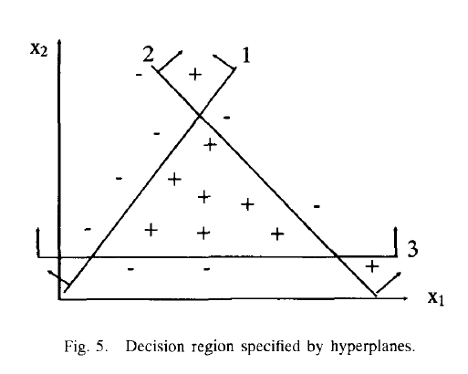
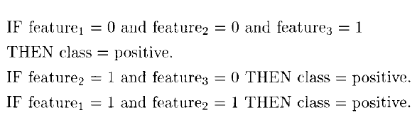
© 2007 Cios / Pedrycz / Swiniarski / Kurgan

